Slide 1




Beyond the Horizon
The Polish Legacy of 2148

Slide 2




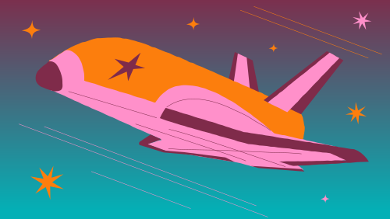

“Beyond the Horizon: The Polish Legacy of 2148” transports players to a future beyond our solar system.
Year 2148. Humanity's technology has advanced to explore the farthest reaches of the Milky Way. In "Pirx Mission," you’ll join Dr. Mikołaj Cieslak of the International Academy of Space Sciences as he leads
a groundbreaking mission to the exoplanet Pirx.
Explore the mysteries of this distant world and uncover the rich legacy of Poland’s contributions to extraterresial exploration. Are you ready to take part in shaping the future of humanity in the cosmos?

Slide 3
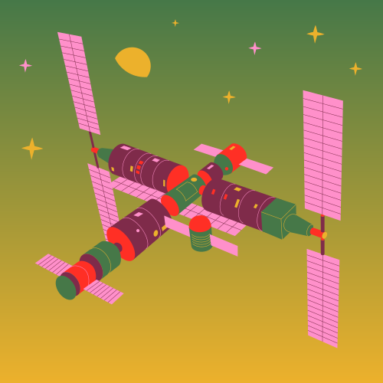


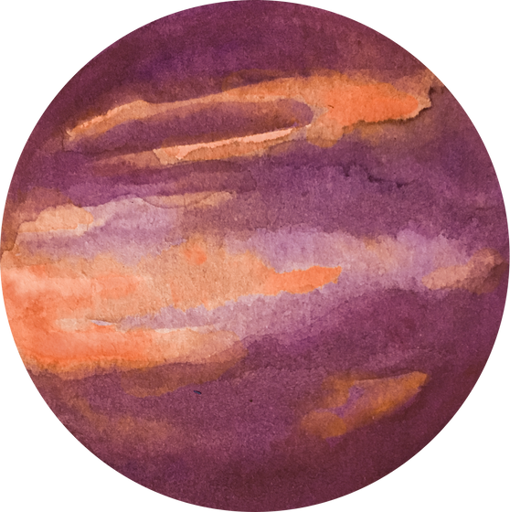
Discover a diverse array of knowledge and exciting modes to suit every player's interest
Explore distant planets, conduct experiments
8-bit exploration mode
Explore far from home planet Pirx, collect and analyze data, survive to expand our understanding of the universe
concept art
Discover how real-world rovers are engineered to endure extreme conditions, avoid mission failures, and gain insight into the overall workings of space missions, including their objectives and challenges with rover simulator

Slide 4
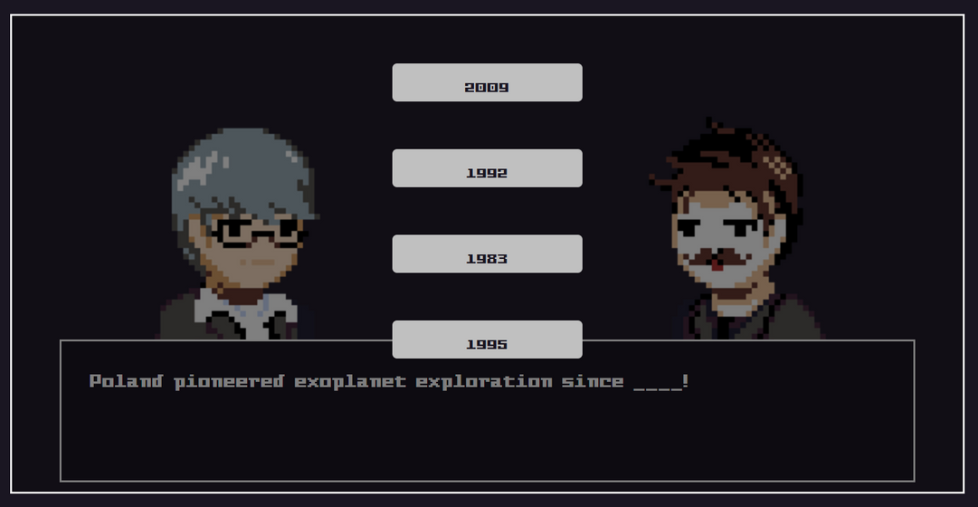
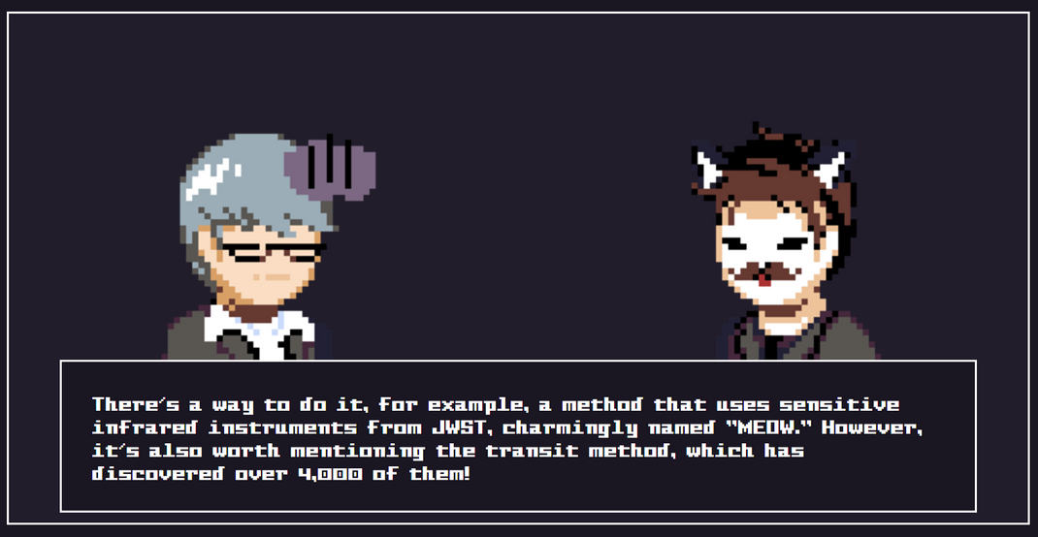
And spread knowledge about the rich history of extraterrestrial exploration
Story mode
Join scientists in work for International Academy of Space Sciences and take part in making history with various interesting personalities.
Immerse yourself in the history of space exploration and learn about the significant contributions of Polish scientists who have shaped our understanding of the universe with interactive visual novel.

Slide 5

Play
Learn
Share your knowledge with others!

Slide 6


Created by
Team “Pirx”
May the Earth be a sphere to you!

